Slide 1
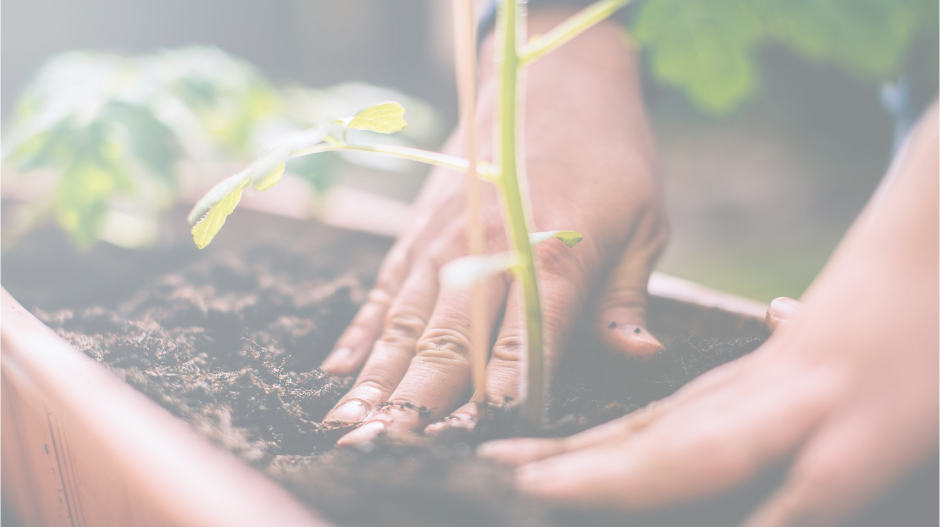

ACT: Architectural Carbon Modeling Tools
@ MICRO 2024
Tutorial
Leo Han
Udit Gupta

Slide 2
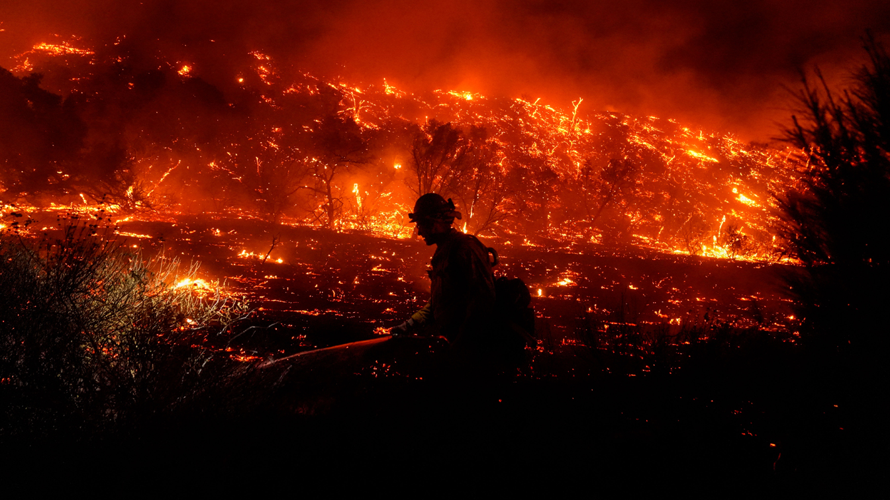

Slide 3
Climate change is an existential threat to our society that requires
immediate, collective actions across all communities and industries.

Slide 4




Computing incurs a growing environmental footprint
1.2-2.2 Billion tons of CO₂
On par with the aviation industry’s footprint
2.1 - 3.9% of worldwide emissions (Freitag’21)
Data center
Mobile
Communication
Computing’s emissions are rising given its growing demand!
Notes:
When we aggregate computing environmental impact across mobile, communication, and data centers, studies show that computing accounts for 900 million metric tons of CO2.
That’s on par with the aviation industry’s footprint and around 2-4% of worldwide emissions.
Not only is this a huge amount already but we find that ICT emissions are expected to double over the next decade given the growing demand for computing.
And so it’s crucial that we as a community start think about what it means for computing itself to be sustainable.

Slide 5
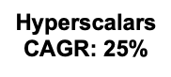
Growing rate of data center energy consumption
Annual electricity consumption
(TWh)
Notes:
Hyperscalers → Ireland (28% of grid datacenters usage in 2031), Northern VA (50% in 2038)

Slide 6
Growing rate of data center energy consumption
25% CAGR
20% CAGR
Annual electricity consumption
(TWh)
Notes:
Hyperscalers → Ireland (28% of grid datacenters usage in 2031), Northern VA (50% in 2038)

Slide 7
Growing rate of data center energy consumption
Annual increase in US renewables (7% CAGR)
Data center growth accounts for ~45% of new renewables
25% CAGR
20% CAGR
Annual electricity consumption
(TWh)
Notes:
Hyperscalers → Ireland (28% of grid datacenters usage in 2031), Northern VA (50% in 2038)

Slide 8
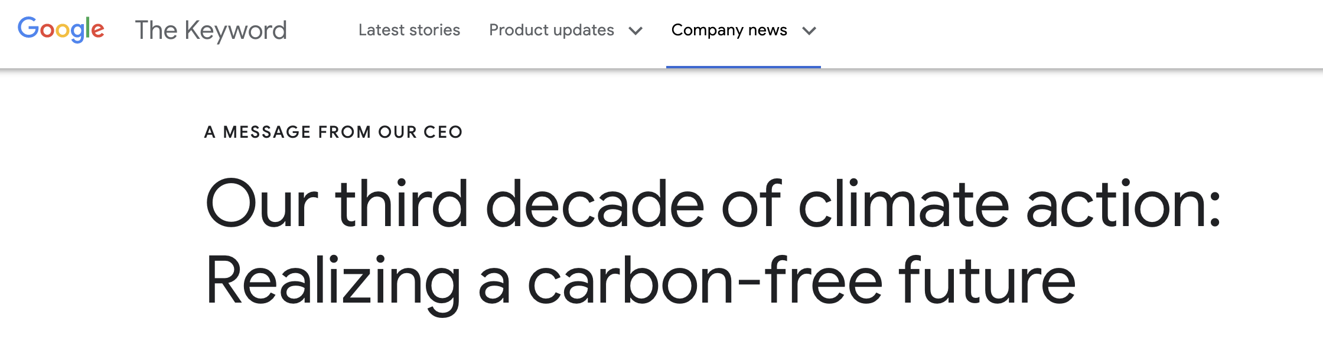
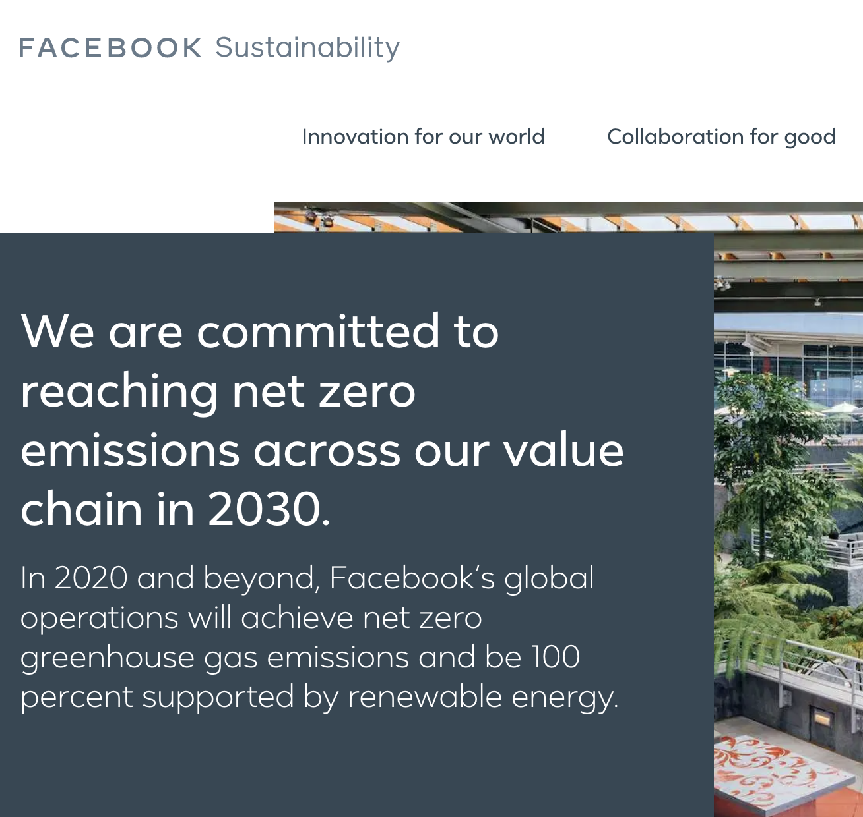
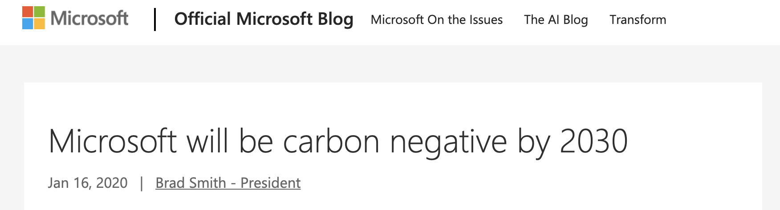
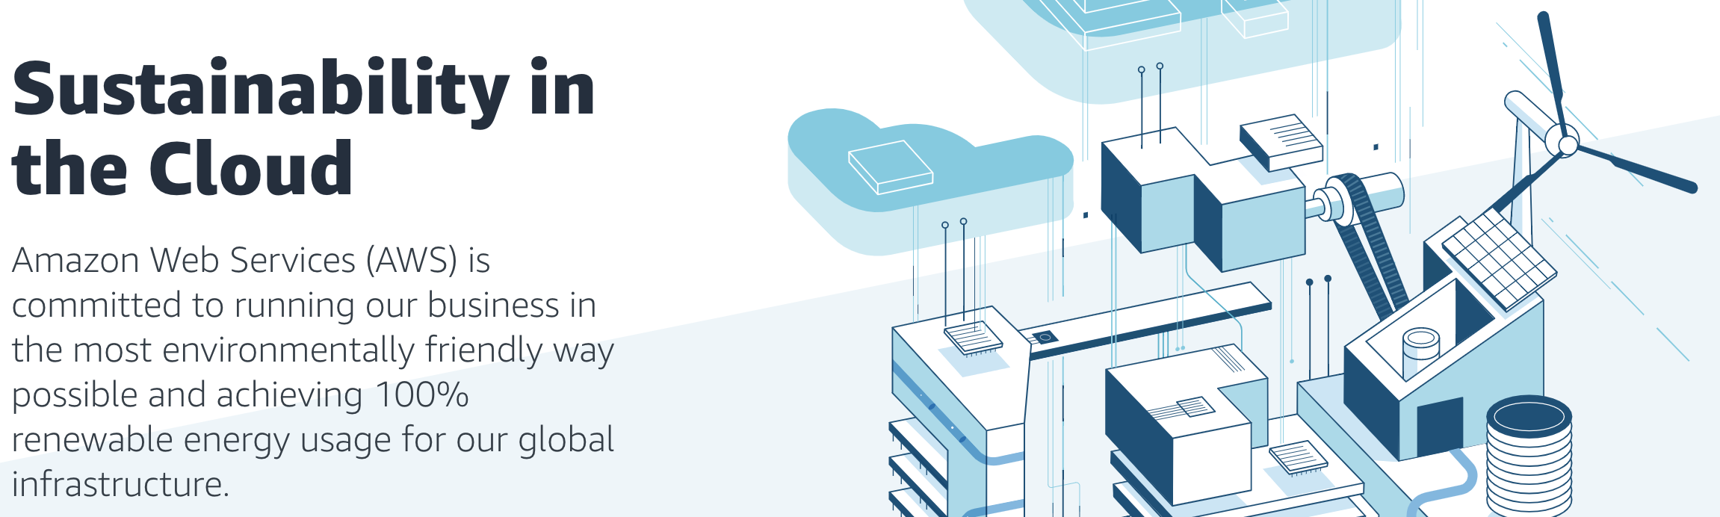
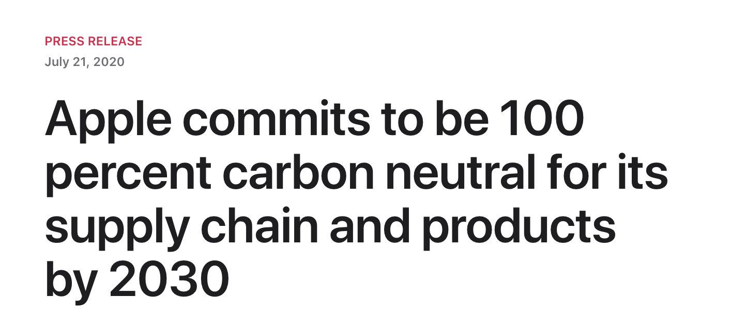
Tech. companies are pledging carbon neutrality
Notes:
For instance, Google, Microsoft, Facebook, Apple, Amazon, and others have pledged to reach carbon neutrality over the next decade.
In this talk we explore, what role computer systems and architecture researchers and developers can play in achieving sustainable computing going forward.

Slide 9
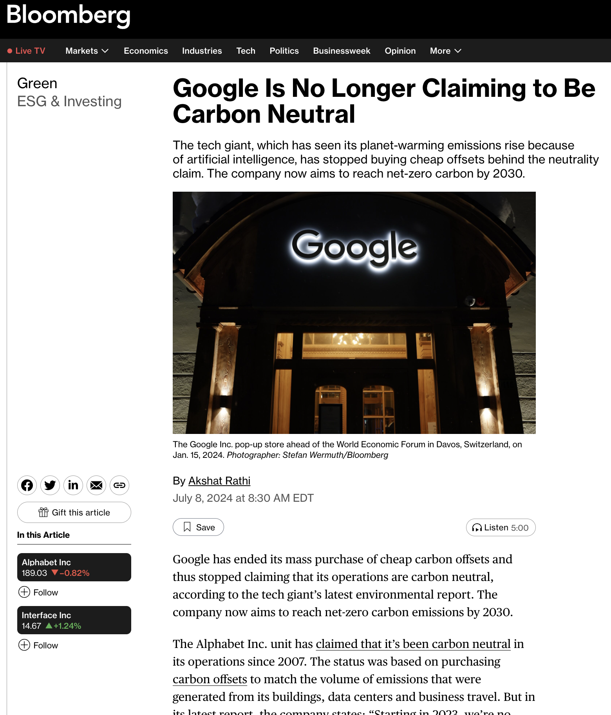
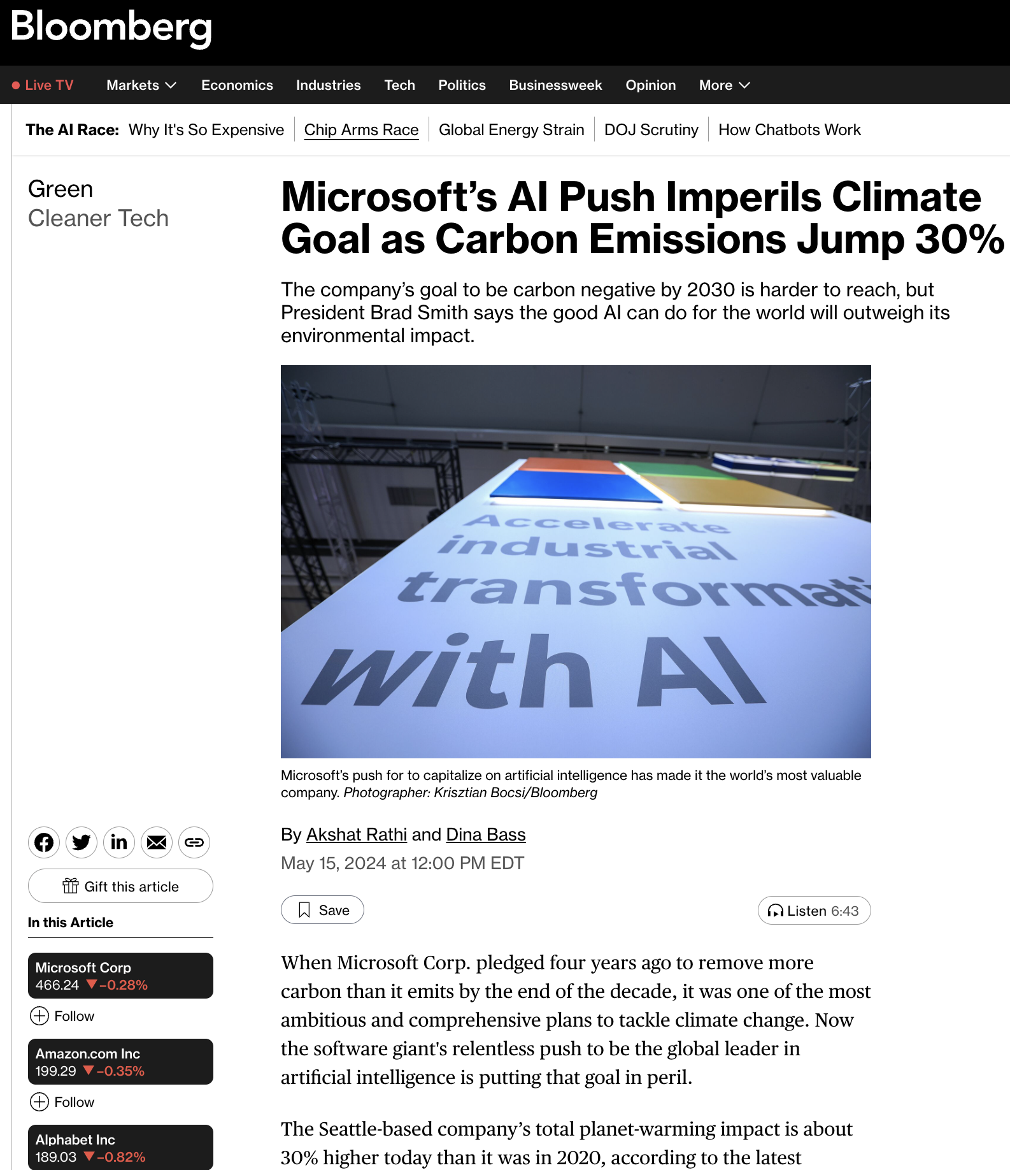
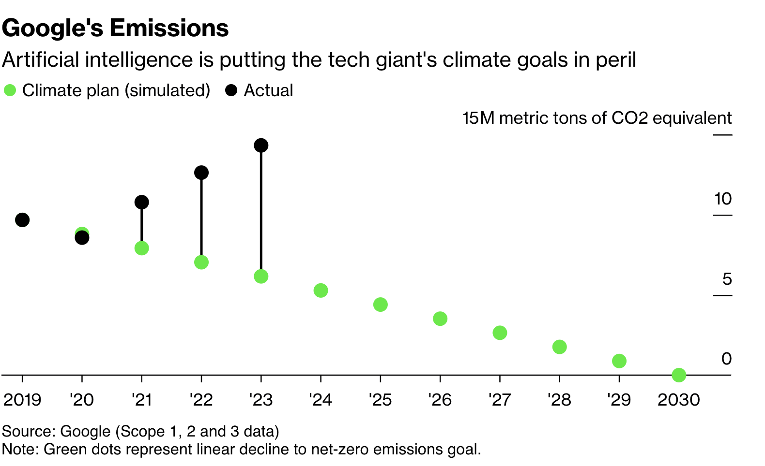
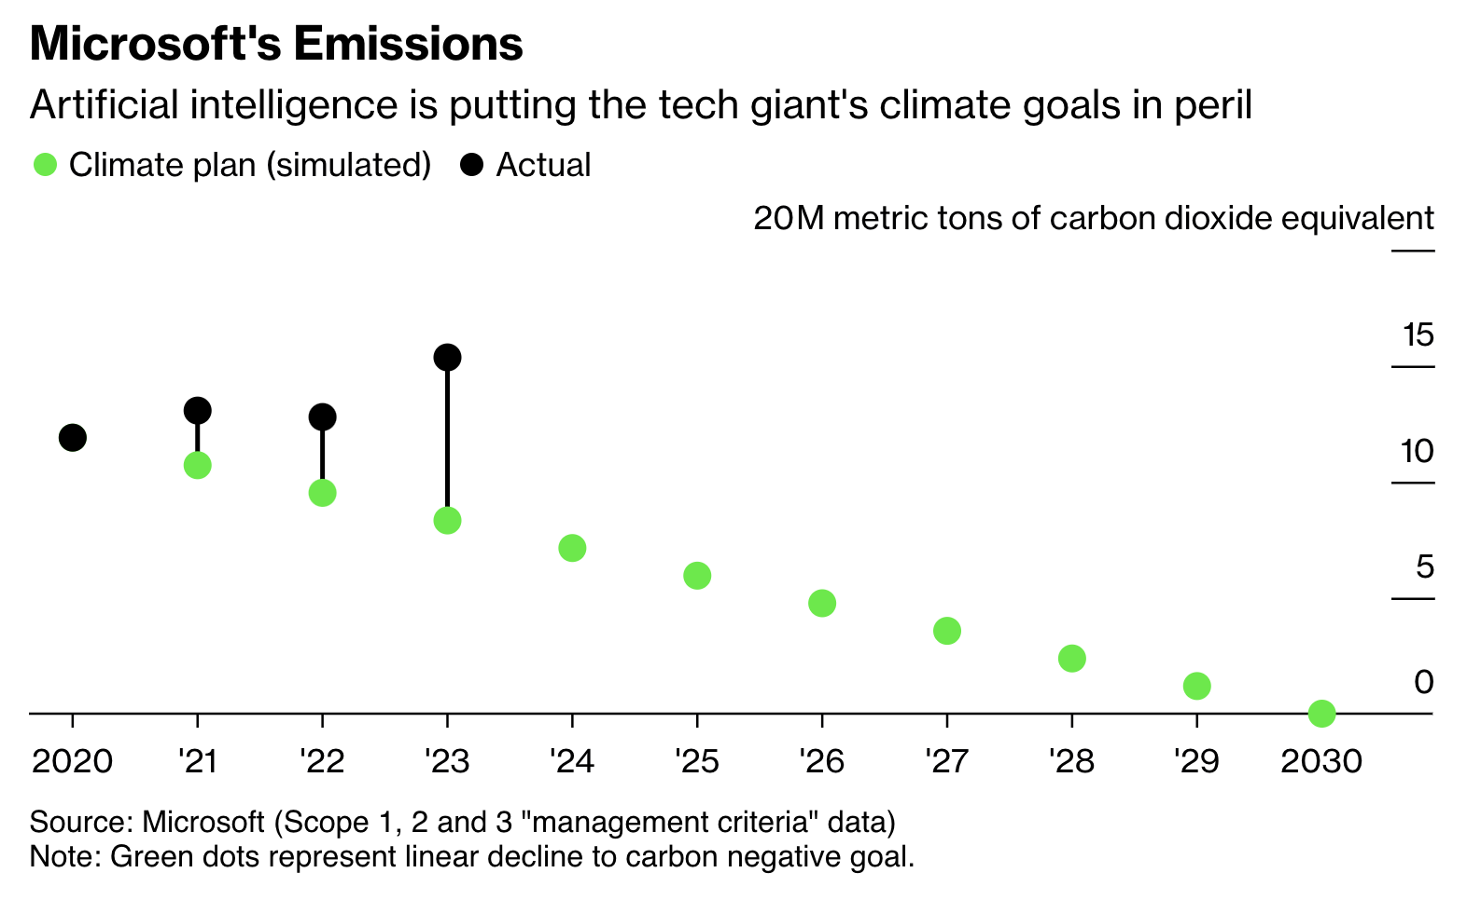
Notes:
Hyperscalers → Ireland (28% of grid datacenters usage in 2031), Northern VA (50% in 2038)

Slide 10
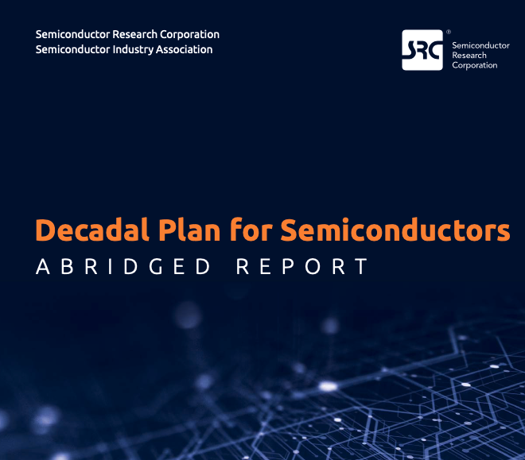
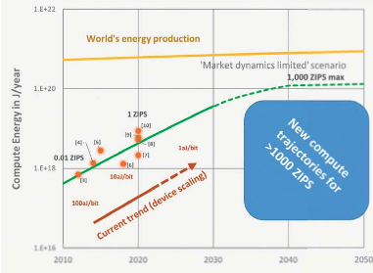
SRC decadal plan calls attention to ICT rising energy footprint
Ever-rising energy demand for computing vs. global energy production is creating new risk,
and new computing paradigms offer opportunities to dramatically improve energy efficiency.
Notes:
Specifically we ask the question, where does computing’s carbon footprint come from?
In our journey to answer this question what we found was quite surprising to some of our collaborators that have spent a lot of time thinking about hardware performance and energy efficiency optimizations.

Slide 11
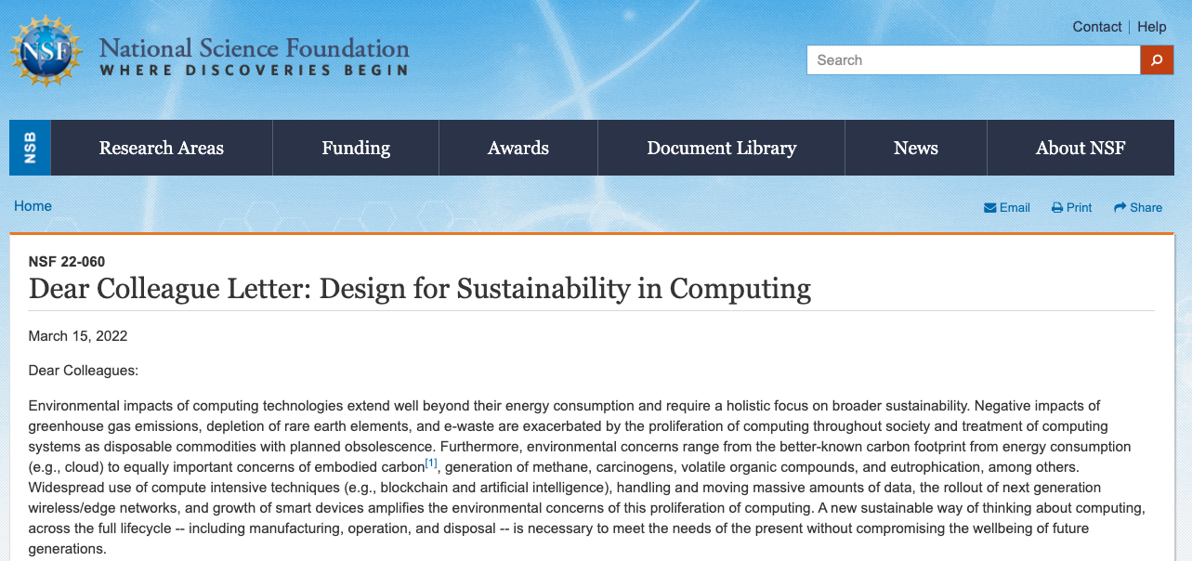
NSF Dear Colleague Letter on Sustainable Computing
DCL
VMWare NGSDI
SRC Decadal Plan
https://www.nsf.gov/pubs/2022/nsf22060/nsf22060.jsp

Slide 12
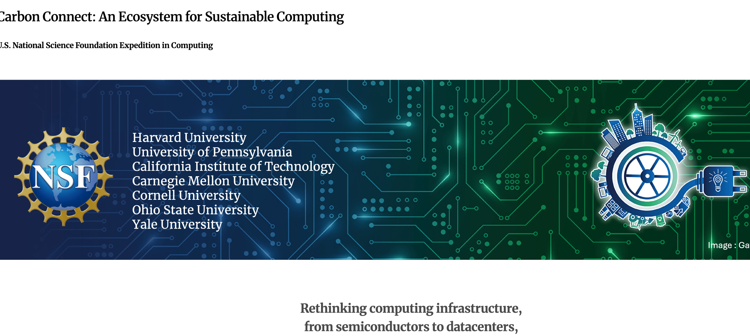
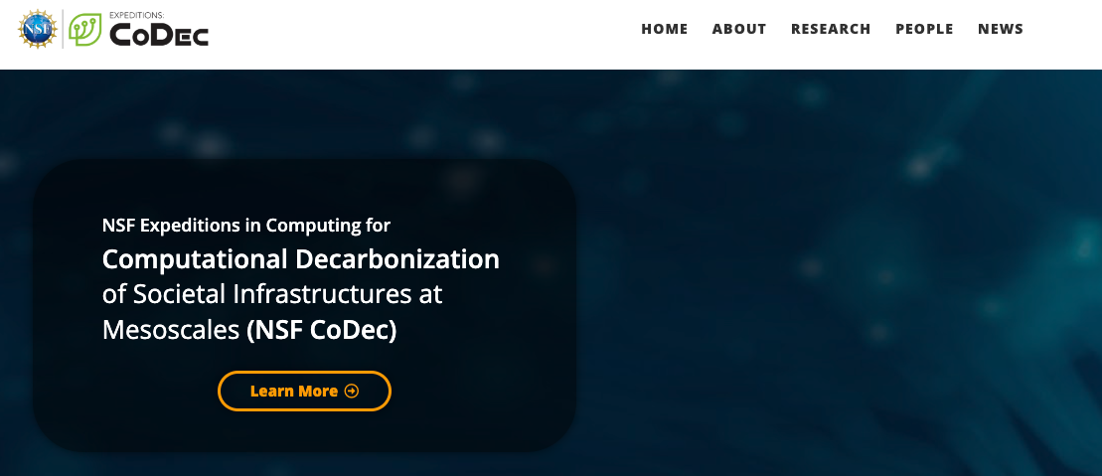
NSF Expeditions in Computing

Slide 13
ACT Tutorial Motivation and Goals
Provide the necessary background and tools to enable researchers to incorporate sustainable as a first order design target
Provide a brief overview of the sustainability implications of modern systems,
Detail the ACT methodology,
Demonstrate how to use ACT,
Demonstrate how to extend ACT
Notes:
Specifically we ask the question, where does computing’s carbon footprint come from?
In our journey to answer this question what we found was quite surprising to some of our collaborators that have spent a lot of time thinking about hardware performance and energy efficiency optimizations.

Slide 14

ACT Tutorial: Today
Time | Topic
1:00 – 1:15pm | Welcome to the ACT tutorial!
1:15 – 1:30pm | Motivation: Understanding the source of computing’s emissions
1:30 – 2:15pm | Overview of ACT: An Architectural Carbon Modeling Tool
2:15 –2:45pm | Hands-on ACT demo’s
2:45 – 3:00pm | Extending ACT
3:00 – 3:30pm | Coffee break
Notes:
Finally, given our understanding of carbon emissions, we will conclude by charting paths for how to design future sustainable computing systems.

Slide 15
ACT Tutorial: Today
Time | Topic
3:00 – 3:30pm | Coffee break
3:30 – 4:30pm | Designing Cloud Servers for Lower Carbon | Jaylen Wang (Carnegie Melon University)
 | Extending ACT to evaluate HI and FPGA for Sustainable Computing | Chetan Choppal (Arizona State University)
 | Carbon-Efficient Optimization for Computing Systems | Mariam Elgamal (Harvard University)
 | Silicon-Photonics for Sustainable AI | Farbin Fayza (Boston University)
 | Energy-/Carbon- Aware Evaluation of 3D IC Architectures with DCIM | Hyung Joon Byun (Cornell Tech)
 | Group discussion
Notes:
Finally, given our understanding of carbon emissions, we will conclude by charting paths for how to design future sustainable computing systems.

Slide 16
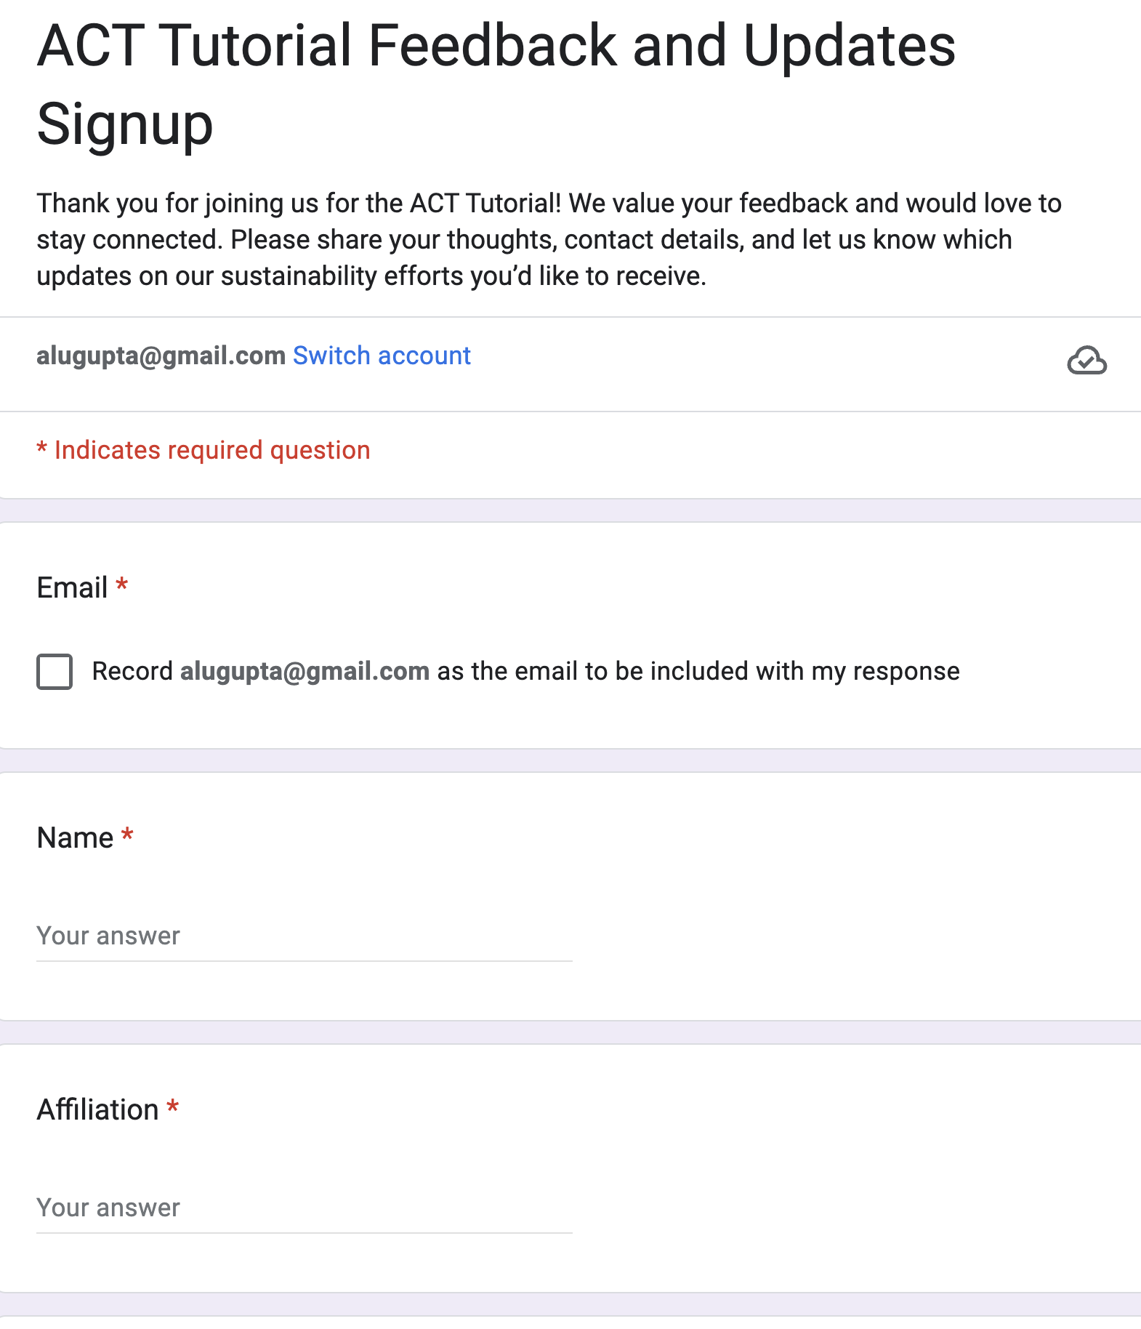

Sign up!

Slide 17
ACT Tutorial: Today
Time | Topic
1:00 – 1:15pm | Welcome to the ACT tutorial!
1:15 – 1:30pm | Motivation: Understanding the source of computing’s emissions
1:30 – 2:15pm | Overview of ACT: An Architectural Carbon Modeling Tool
2:15 –2:45pm | Hands-on ACT demo’s
2:45 – 3:00pm | Extending ACT
3:00 – 3:30pm | Coffee break
Notes:
Finally, given our understanding of carbon emissions, we will conclude by charting paths for how to design future sustainable computing systems.

